Slide 1
Your International Experience at WU!
WU International Office
January 2023
Notes:
Part of the outgoing and partnerships team

Slide 2
Overview
Austria & Vienna
WU – Vienna University of Economics and Business
Exchange semester, Special Programs and International Summer University^{WU}
Questions and Answers

Slide 3
Austria
Location
Center of Europe
8 neighboring countries
Official language
(Austrian) German
Population
~ 8,800,000
Notes:
Great opportunities to travel due to the central location in the heart of Europe.

Slide 4
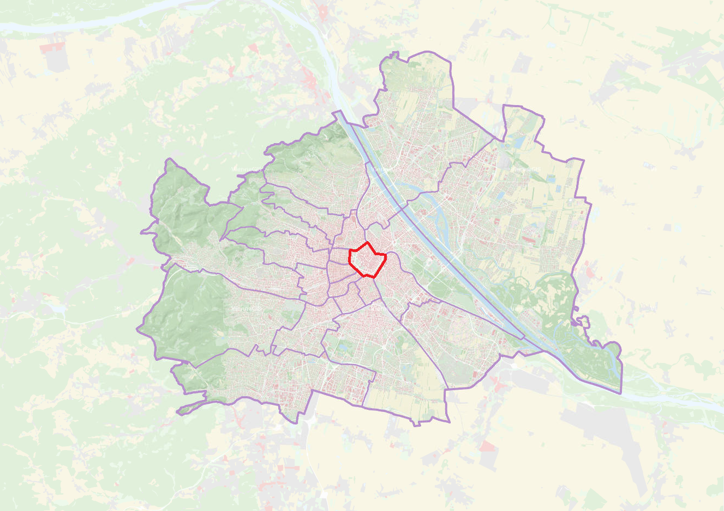
I
Notes:
Vienna has 23 districts. Inner city

Slide 5
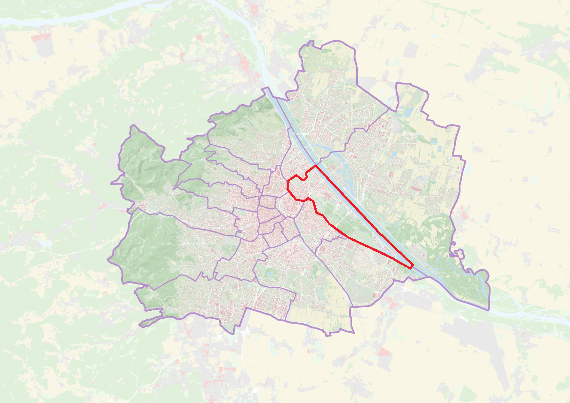
II
Notes:
Location of WU, 2nd district, located very centrally

Slide 6
Vienna
Population: ~ 1.9 million
Metropolitan area: 2.6 million
1st rank Global Liveability Index 2022 (Economist Intelligence Unit)
17 universities
Vast public transport system
Notes:
Vienna ranked first as the most livable city in the world. The ranking by the Economist Group compared 173 cities worldwide and considers the factors stability, healthcare, culture and environment.
Links:
Mercer: https://www.mercer.com/newsroom/2018-quality-of-living-survey.html
Economist Intelligence Unit (Guardian-Artikel): https://www.theguardian.com/australia-news/2018/aug/14/vienna-named-worlds-most-liveable-city-as-melbourne-loses-crown
Polizeiliche Kriminalstatistik 2017: https://bundeskriminalamt.at/501/files/PKS_17_Broschuere_Web.pdf (p. 27 auf Englisch)
Credit:
Donau (50401): © WienTourismus/Christian Stemper;
Blick auf den Volksgarten, Museen und Parlament (40711): © WienTourismus/Christian Stemper;
Sommertage an der Alten Donau (40981): © WienTourismus/Christian Stemper

Slide 7
Notes:
Vienna has a great public transportation system, which consist of trams, subway lines, buses and trains
Mit der Strassenbahn um die Ringstrasse (50204): © WienTourismus / Peter Rigaud

Slide 8
Notes:
A lot of cycle paths
Radfahren am Ring (50150): © WienTourismus / Peter Rigaud

Slide 9
Notes:
A rich cultural heritage. Castles, monuments, museums, theaters

Slide 10
Notes:
A lot of options to go out
Tanzcafé Jenseits (40282): © WienTourismus / Peter Rigaud

Slide 11
WU – Vienna University of Economics and Business

Slide 12
Introduction to WU
Founded in 1898
Focus on business and economics
Number of students
~ 21,200 (fall 2021)
27% international students
Incoming/outgoing ratio
1,000 incoming students
1,000 outgoing students
Notes:
WU not a comprehensive university but specialized in Economics and Business
Since 2014: new Campus
Additional info:
https://www.wu.ac.at/fileadmin/wu/s/io/downloadcenter-en/WU_information/2018-07-20_Introduction_to_WU.pdf

Slide 13
Accreditions and Rankings
Since 2015, WU has held triple accreditation by EQUIS, AACSB, and AMBA, the 3 most prestigious accreditation agencies for business and economics universities.
More information is available at: https://www.wu.ac.at/en/the-university/about-wu/accreditations
Economist Ranking (Masters in Management 2019 Ranking)
WU Master’s in International Management placed 5th out of 40 programs (2nd place in the German-speaking area)
Financial Times Ranking (Masters in Management Ranking 2022)
WU Master’s in International Management placed 28th out of 100 programs (3rd place in the German-speaking area)
European Business School Ranking 2022
WU placed 43th of 95 European schools ranked
QS Rankings (QS World University Ranking by Subject 2022)
Overall Ranking Social Sciences & Management: 119
In Business & Management Studies: 36
Shanghai Academic Ranking of World Universities in
Business Administration 2022
WU placed among the top 101-150 universities
Management 2022
WU placed among the top 151-200 universities
More information is available at: https://www.wu.ac.at/en/the-university/about-wu/rankings

Slide 14
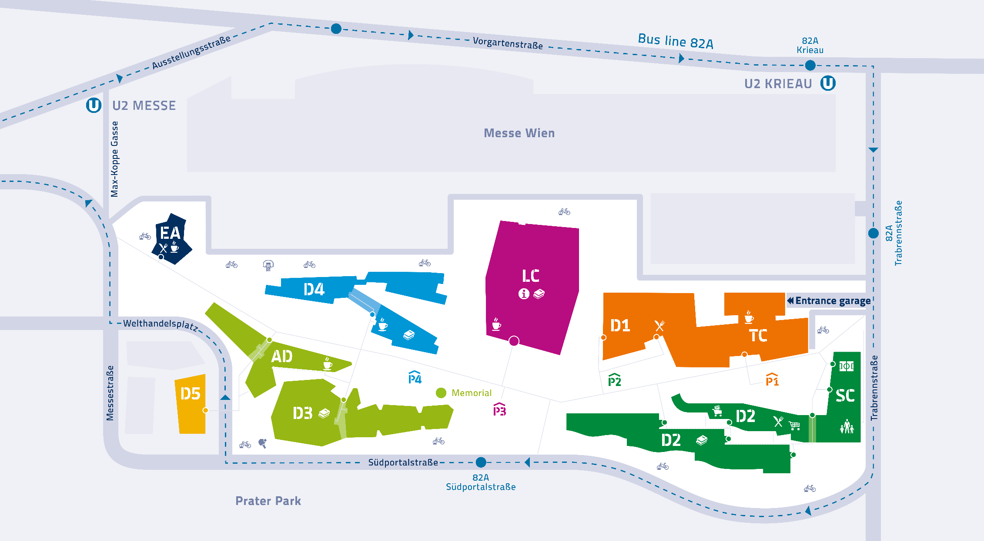
Notes:
All buildings are located at one Campus. Whenever you have classes you will have them at this campus. There is no accommodation on campus. (Library and Learning Center, Teaching Center, various department buildings, Mensa cafeteria)

Slide 18
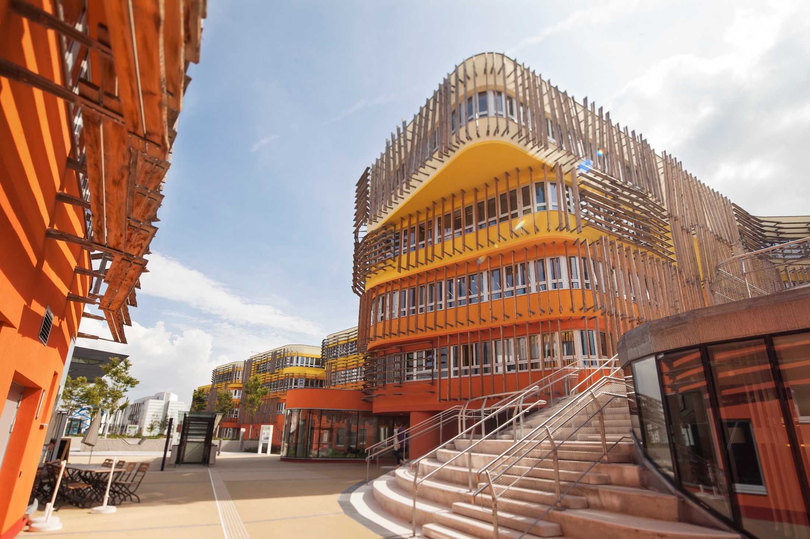

Slide 19
Your exchange semester

Slide 20
Studying at WU
Exchange students must be nominated by one of WU´s partner universities
Structure academic year
Winter semester
Summer semester
Language requirements
Undergraduate exchange students: B2 level (CEFR) English and/or German
Graduate students: C1 level (CEFR) English and/or German
Notes:
No freemover.
You have to apply at your home university.
No trimester.
https://www.wu.ac.at/studium/incoming-students/exchange-semester/dates-and-deadlines/

Slide 21
Studying at WU: Courses
Courses in English and German (e.g. Marketing, HRM, International Business, Law, Economics, Management Information Systems, Social Responsibility)
Around 200 courses taught in English for incomings (stable course range each semester)
Reserved spots for incomings in regular courses + courses for incomings only
Course catalog for incomings https://wu.ac.at/io/courses
Notes:
Courses in English and German
https://wu.ac.at/io/courses

Slide 22
Studying at WU: Residence Halls
Student residence halls
OeAD Housing, Student Hotel Vienna, Campus Studios, Linked Living Apartments, Milestone, Room4rent
Private accommodation
Housing Anywhere

Slide 23
Other offers
Erasmus Buddy Network
Optional pre-semester activities
Orientation & Cultural Program
Pre-semester German Language course
German courses (fee-based) at all levels during the semester

Slide 24
Inclusion and Accessability
We gladly welcome students with physical, mental, and health-related conditions.
Barrier-free campus
Services such as BeAble, Student Counselling, and an Ombuds Office for Students.
Certain student residence halls with wheelchair-accessible and barrier-free facilities.
Students require assistance or other support services -> contact the international office of their home university, which will then in turn inform the regional coordinator at WU Vienna.
We are happy to assist and organize needed services if necessary!

Slide 25
Per month
Housing | approx. € 450-650
Insurance | approx. € 60
Food & personal expenses | approx. € 220-300
Utilities (phone,...) | approx. € 15-30
Entertainment | approx. € 50-150
Please note
No tuition fees at WU
But you HAVE TO pay the ÖH fee
Per semester
Vienna public transportation | approx. € 75-156
Books | approx. € 75-150
Students‘ Union (ÖH) fee | approx. € 22
Total cost | € 840 – 1,270 per month

Slide 26
Special Program at WU – THEMIS

Slide 27
THEMIS
THEMIS is a network made up of 12 top universities in Europe and Asia
Graduate students in business law and international law
3 core elements:
semester abroad
tailor-made business law course tracks
international internship
THEMIS seminar/paper
Students receive the program’s
Joint Certificate in International and Business Law

Slide 28
Your International Short Program at WU

Slide 29
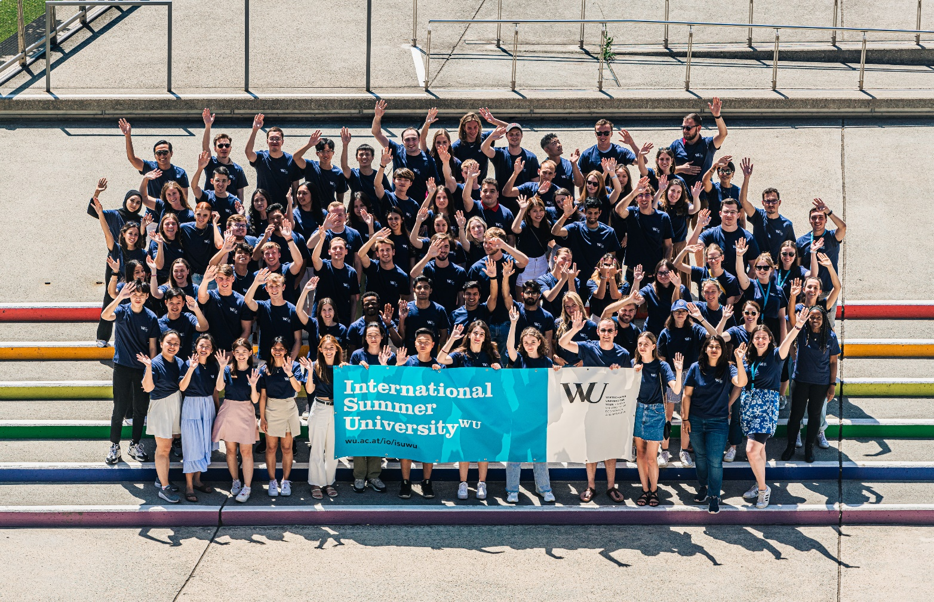
International Summer University WU (ISU^{WU})
3-week program in summer (one session in July, one in August) at WU in Vienna
Courses taught in English in a broad range of business topics
Social and cultural program is organized for the participants
Open to graduate and undergraduate students
Program structure: 2 intensive courses, each course lasts 1,5 weeks; students earn 4 ECTS credits per course
More information is available at https://short.wu.ac.at/isuwu
Notes:
https://www.wu.ac.at/studium/incoming-students/international-summer-university-wu/

Slide 30
Useful links
Information for prospective exchange students: https://www.wu.ac.at/en/programs/incoming-students/exchange-semester/for-prospective-exchange-students-student-life-in-vienna
International Office website: https://www.wu.ac.at/en/programs/incoming-students
Themis program: https://www.wu.ac.at/en/programs/incoming-students/themis
International Summer University^{WU}: www.wu.ac.at/io/isuwu

Slide 31
INTERNATIONAL OFFICE
Welthandelsplatz 1, 1020 Vienna, Austria
www.wu.ac.at/io Instagram: @wuinternationaloffice
Contact for incoming students
incoming@wu.ac.at
Contact International Summer University^{WU}
isuwu@wu.ac.at

